Slide 1
Politecast, and more
Marcus Lundén, QCAT/CSIRO
2012 feb 27

Slide 2
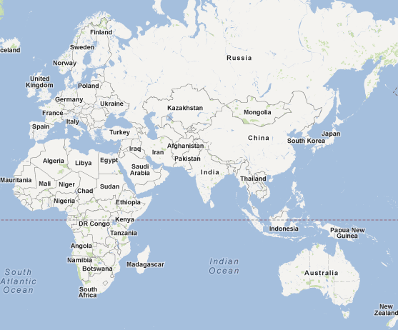
Stockholm

Slide 3
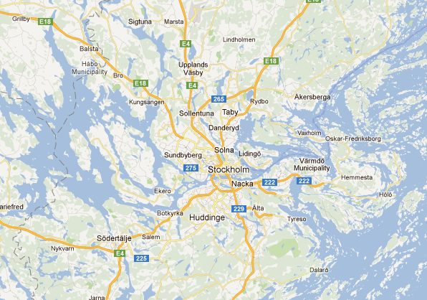
Stockholm

Slide 4

Notes:
Old town, Royal Castle and parts of the city center

Slide 5
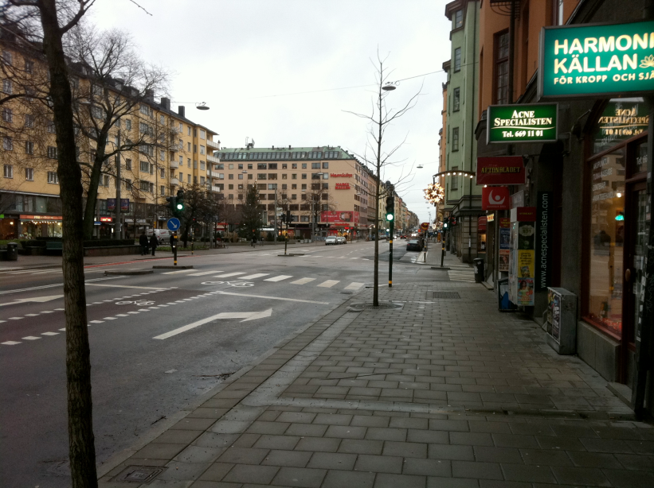

Slide 6

Notes:
No polar bears on our streets

Slide 7

Notes:
sank after sailing less than 2 km into its maiden voyage on 10 August 1628.
333 years on the bottom
salvaged with a largely intact hull in 1961, now on display in the Vasa museum in central Sthlm

Slide 8
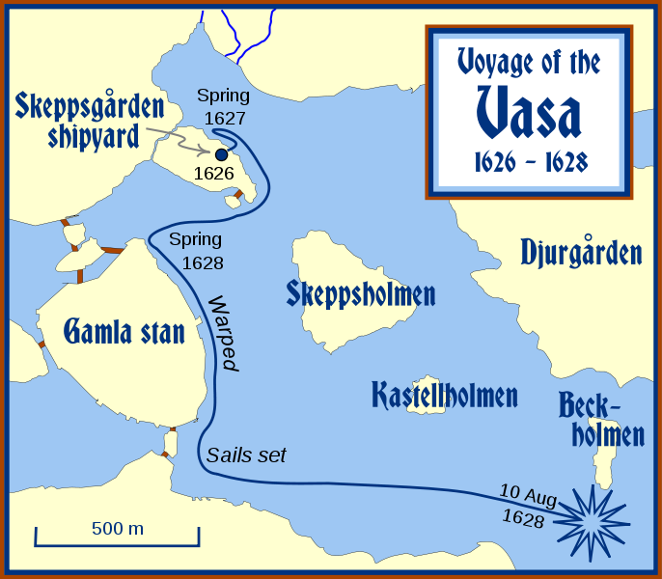
Notes:
sank after sailing less than 2 km into its maiden voyage on 10 August 1628.
333 years on the bottom
salvaged with a largely intact hull in 1961, now on display in the Vasa museum in central Sthlm

Slide 9
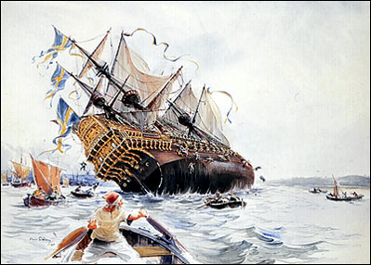
Notes:
sank after sailing less than 2 km into its maiden voyage on 10 August 1628.
333 years on the bottom
salvaged with a largely intact hull in 1961, now on display in the Vasa museum in central Sthlm

Slide 10
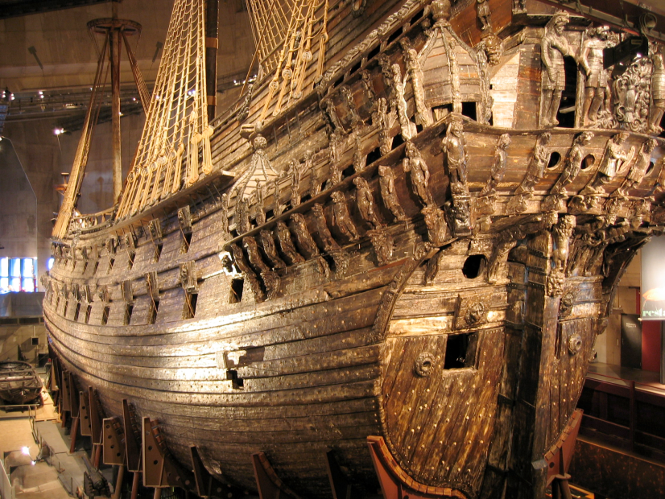
Notes:
sank after sailing less than 2 km into its maiden voyage on 10 August 1628.
333 years on the bottom
salvaged with a largely intact hull in 1961, now on display in the Vasa museum in central Sthlm

Slide 11
Politecast
Notes:
Politecast does that. By assuming that all nodes that are interested already listens, it does’t have to wake them up. That way the packet only needs to be transmitted once.
This requires receivers to listen when they are interested. This is what R1 does here. Note that R2 isn’t disturbed. It is still sleeping and will not receive the politecast transmission from S.
(in something or anticipate a particular transmission to be sent. )

Slide 12
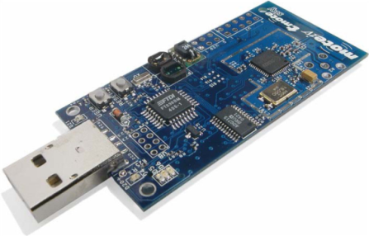
Notes:
Politecast does that. By assuming that all nodes that are interested already listens, it does’t have to wake them up. That way the packet only needs to be transmitted once.
This requires receivers to listen when they are interested. This is what R1 does here. Note that R2 isn’t disturbed. It is still sleeping and will not receive the politecast transmission from S.
(in something or anticipate a particular transmission to be sent. )

Slide 13
mW
Tx 1 byte ~ 2200 cycles
Notes:
Politecast does that. By assuming that all nodes that are interested already listens, it does’t have to wake them up. That way the packet only needs to be transmitted once.
This requires receivers to listen when they are interested. This is what R1 does here. Note that R2 isn’t disturbed. It is still sleeping and will not receive the politecast transmission from S.
(in something or anticipate a particular transmission to be sent. )

Slide 14
MAC
Traditionally:
Throughput
Latency

Slide 15
MAC @ WSN
Power efficiency
Scalability

Slide 16
Hot Research Area
S-MAC [INFO-COM 2002]
X-MAC [SenSys 2006]
RI-MAC [SenSys 2008]
In Contiki: ContikiMAC

Slide 17
S-MAC (TDMA)
listening
A
B
C
t
Notes:
So result is this, all nodes in range of the sender is awakened to receive the message.

Slide 18
X-MAC (LPL)
listening
A
B
C
t
Notes:
So result is this, all nodes in range of the sender is awakened to receive the message.

Slide 19
ContikiMAC (LPL)
2*CCA
A
B
C
t
Notes:
So result is this, all nodes in range of the sender is awakened to receive the message.

Slide 20
RI-MAC (LPP)
transmitting probe
listening
A
B
C
t
Notes:
So result is this, all nodes in range of the sender is awakened to receive the message.

Slide 21
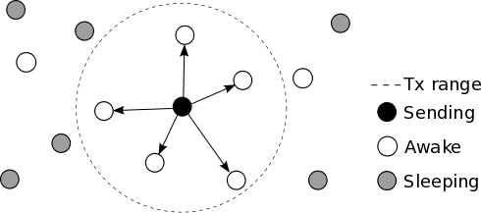
Broadcast
Notes:
So result is this, all nodes in range of the sender is awakened to receive the message.

Slide 22
S-MAC (TDMA)
A
B
C
Packet + ACK
Notes:
So result is this, all nodes in range of the sender is awakened to receive the message.

Slide 23
X-MAC (LPL)
A
B
C
Preamble + packet
Notes:
So result is this, all nodes in range of the sender is awakened to receive the message.

Slide 24
ContikiMAC (LPL)
1st partly rx, wait for next
A
B
C
Repeated tx
Notes:
So result is this, all nodes in range of the sender is awakened to receive the message.

Slide 25
RI-MAC (LPP)
A
B
C
t
Notes:
So result is this, all nodes in range of the sender is awakened to receive the message.

Slide 26
Motivating Example
Notes:
So result is this, all nodes in range of the sender is awakened to receive the message.

Slide 27
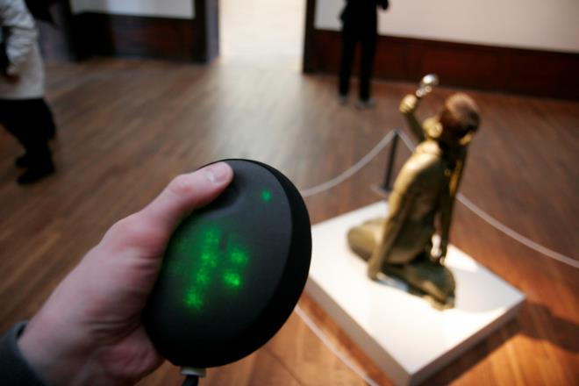
Lega
Notes:
The system consists of mobile devices, the Legas, and static infrastructure nodes. Each person carries a Lega and by touching and moving it creates an impression that shared with the friends. This sensor data is then transmitted to and stored in the infrastructure node closest to that particular position. When another user later passes by, the trace will be sent to that Lega and played back with vibrations and light.

Slide 28

Lega
Notes:
The system consists of mobile devices, the Legas, and static infrastructure nodes. Each person carries a Lega and by touching and moving it creates an impression that shared with the friends. This sensor data is then transmitted to and stored in the infrastructure node closest to that particular position. When another user later passes by, the trace will be sent to that Lega and played back with vibrations and light.

Slide 29
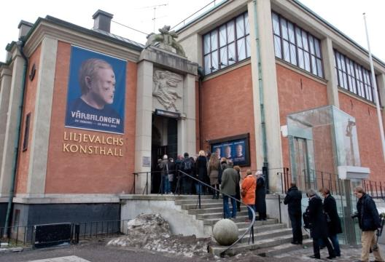
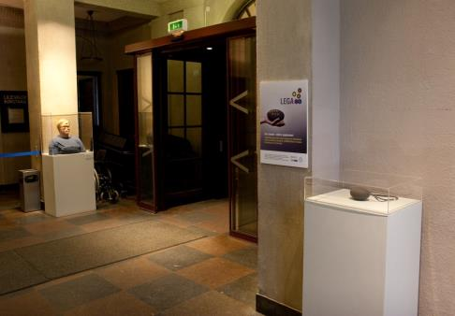
Lega @ Liljevalchs
Notes:
In the Supple project, we deployed a quite different wireless sensor network at the Liljevalchs art exhibition in the spring of 2010. With a mobile device each, friends can share impressions in a nonverbal way with eachother in the art exhibition.
We built the system ourselves. I was involved in both hardware and software but mostly software as I wrote most of the firmware for the system.

Slide 30
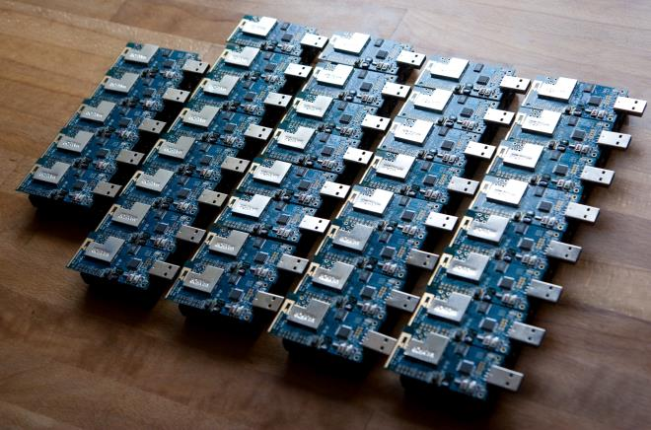
Lega Infrastructure
Notes:
Gör slides som visar hur allt händer (rör sig, skickar, tar emot) steg för steg!! Kanske zooma in?

Slide 31
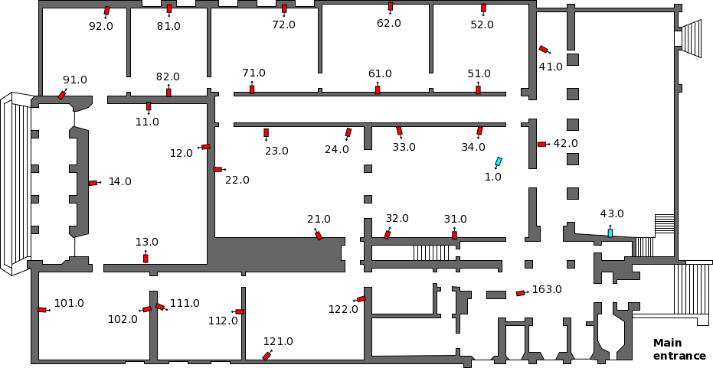
Lega Infrastructure
Notes:
Gör slides som visar hur allt händer (rör sig, skickar, tar emot) steg för steg!! Kanske zooma in?

Slide 32

Infrastructure Deployment
Notes:
When we first deployed the infrastructure we noticed that lots of communication was lost and the batteries didn’t last long. This was a huge problem because there were 32 infrastructure nodes, each 5 meters up on a shelf. (The Legas on the other hand was easily accessible as they had to be recharged every day due to the motors and LEDs.)
On a typical sensor node, the radio transceiver is the most power consuming component. It uses about ten times as much power as the microcontroller. If the radio was left on all the time in the Lega infrastructure, roughly 98 % of the power would be consumed by the radio alone. So what can we do?
(this is the IS node w Sky:0.5 mA when static (no Tx). -> 25.2/25.7)

Slide 33
Problems
Congestion
Overhearing Costs
Biased Effort
Notes:
These are three problems with broadcast that I have identified. This is why we had problems with the Lega infrastructure, with short lifetime and poor performance.
The problems are Congestion, Overhearing Costs and Biased Effort.

Slide 34
Problem 1 - Congestion
Too much traffic = collisions
!
!
!
!
!
Notes:
Problem one: there is too much traffic. Collisions will cause corrupt and dropped packets which is a reduces lifetime.

Slide 35
Problem 2 – Overhearing Costs
Not interested?
Your loss.
zZzZzZzZ
Notes:
Problem two: broadcast doesn’t care if a receiver is interested or not. It assumes they are, so it wakes them all up anyway. This is especially serious if the network has a lot of uninteresting traffic, like the Lega infrastructure.
(Uninteresting is not the same as unnecessary, so it cannot be just skipped)

Slide 36

Problem 3 – Biased Effort
Sender spends more energy than receiver
!
!
!
!
!
vs
Notes:
Problem three: the sender must use the radio much more than the receivers. This makes the burden very uneven.

Slide 37
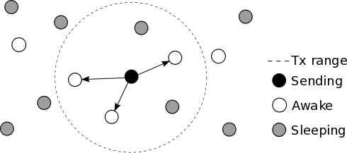
Politecast
Notes:
This is the result. Only those in range and listening will receive the packet.
Politecast is different from broadcast and is not meant to be a replacement. They are qualitatively different and can coexist. Sometimes you want to wake up all nodes, such as in alarm systems. But in other cases, nodes just aren’t interested and they shouldn’t be bothered. There are use cases for both.
(PC not BC replacement, explain that! And explain what the difference is!)

Slide 38
Politecast
Do not wake nodes up
Just transmit, once
Interested? Then listen.
For any duration, at any time
Notes:
Politecast does that. By assuming that all nodes that are interested already listens, it does’t have to wake them up. That way the packet only needs to be transmitted once.
This requires receivers to listen when they are interested. This is what R1 does here. Note that R2 isn’t disturbed. It is still sleeping and will not receive the politecast transmission from S.
(in something or anticipate a particular transmission to be sent. )

Slide 39
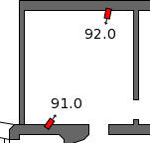

Evaluation (in Lega deployment)
Notes:
Politecast was of course evaluated, in part in the Lega deployment.
The infrastructure nodes transmitted a periodic beacon packet, which the mobile node used for locatlization. The received beacon rate and RSSI was used for that.
Other evaluations included simulations of a mobile network and other benchmarks with real devices.

Slide 40
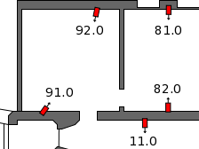
Overhearing
Notes:
Here you see why broadcast was a problem: dense network in an old building that has very low attenuation on the signals as it is made of brick and wood. Therefore there was massive problems with overhearing and as a consequence reduced lifetime as the infrastructure nodes are deprived sleep.
Here are the results

Slide 41
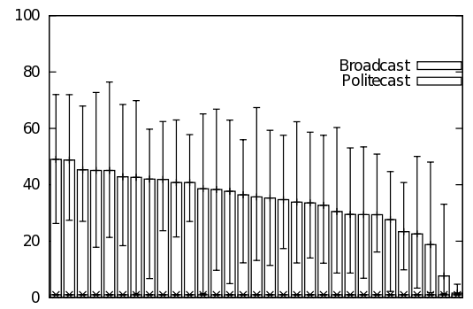
Overhearing Costs
Energy Cost
Broadcast up to 50 times higher!
node
Notes:
Politecast has practically zero overhearing costs as it does not wake up neighbors.
This means that nodes don’t have to spend energy on uninteresting transmissions.
Broadcast on the other hand is affected by the number of neighbors. A node with many neighbors is awakened more often.
Ideally, this energy spent should be the same for all nodes in both implementations.
Instead, we see that broadcast has an up to 50-fold increase in overhearing costs!

Slide 42
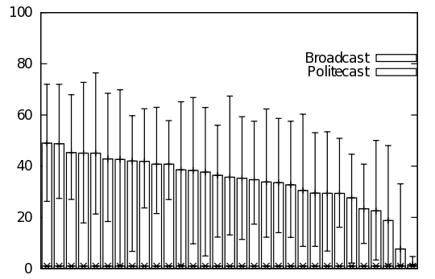
Deterministic Power Consumption
Energy Cost
node
Notes:
Another benefit with not being disturbed by neighbors is that the power consumption becomes deterministic no matter how many neighbors a node has, which means that it is possible to predict lifetime.

Slide 43
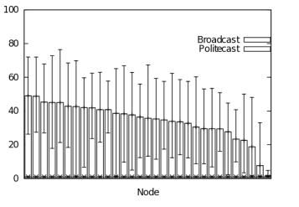
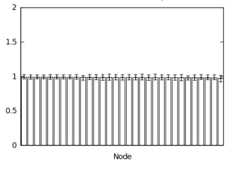
Deterministic Power Consumption
Energy Cost
Energy Cost
Broadcast
Politecast
Lifetime depends on #neighbors
Unaffected by #neighbors
Notes:
If we zoom in on politecast, we see that for all nodes the power consumption is practically the same no matter how many neighbors they have while for broadcast it varies with a factor 50.
In this application, a usage of 1 % is ideal, meaning no incurred costs due to overhearing. We can see that Politecast achieved this, while broadcast had momentary peaks at up to 80 %. This will make the network unpredicatble in terms of lifetime.

Slide 44
Service Outage - Congestion
node
Notes:
Aggravated outage in seconds (during one hour). The nodes with the most neighbors have the highest outage due to congestion causing the MAC to drop packets as it didn’t get a clear channel within a certain time frame. Politecast had no outage.

Slide 45
Conclusion
Assumes disinterest
Single tx, listen
Leverages application knowledge (timers, sensor data) -> listen policy
Addition in designers toolbox
Suitable for some types of traffic
Notes:
Politecast has practically zero overhearing costs as it does not wake up neighbors.
This means that nodes don’t have to spend energy on uninteresting transmissions.
Broadcast on the other hand is affected by the number of neighbors. A node with many neighbors is awakened more often.
Ideally, this energy spent should be the same for all nodes and both implementations.
The red arrow should be like the green. Instead, we see that broadcast has an up to 50-fold increase in overhearing costs!

Slide 46
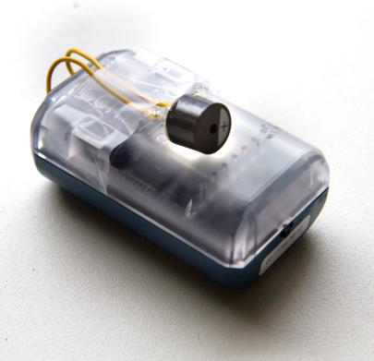
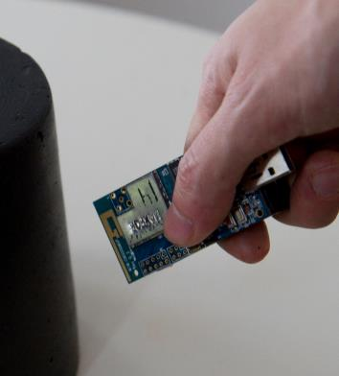
Inspirational Bits
Notes:
BSc project, JUMP
Fight obesity with inactive children

Slide 47
Politecast - a new programming primitive for Wireless Sensor Networks [MSc thesis, KTH Sweden] - Marcus Lundén
The Lega - a device for leaving and finding tactile traces [TEI 2011, Portugal] - Jarmo Laaksolahti, Jakob Tholander, Marcus Lundén, Jordi Solsona Belenguer, Anna Karlsson, Tove Jaensson
The Politecast Communication Primitive for Low-power Wireless [ACM CCR 2011-04] - Marcus Lundén and Adam Dunkel

